Slide 1
Providing Reliable SMB Shares in Microsoft Azure
Sam Cogan

Slide 2



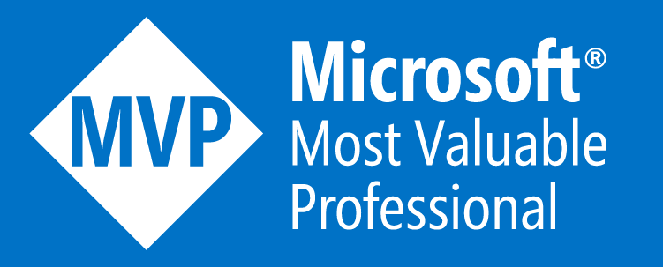


Sam Cogan
Solution Architect – Willis Towers Watson
Microsoft Azure MVP
samcogan.com
@samcogan
sam-cogan

Slide 3




The Challenge
Legacy applications requiring SMB shares
Azure SLA Requirement for High Availability
Operational Requirement for High Availability
Disaster Recovery

Slide 4



The Problem
No Shared Storage
Failover Clusters not supported
Alternative solutions required

Slide 5
SMB Services In Azure
Azure Files
Standalone File Server
Storage Spaces Direct
Storage Replica
Netapp Files
DFSR
Third Party Solutions

Slide 6
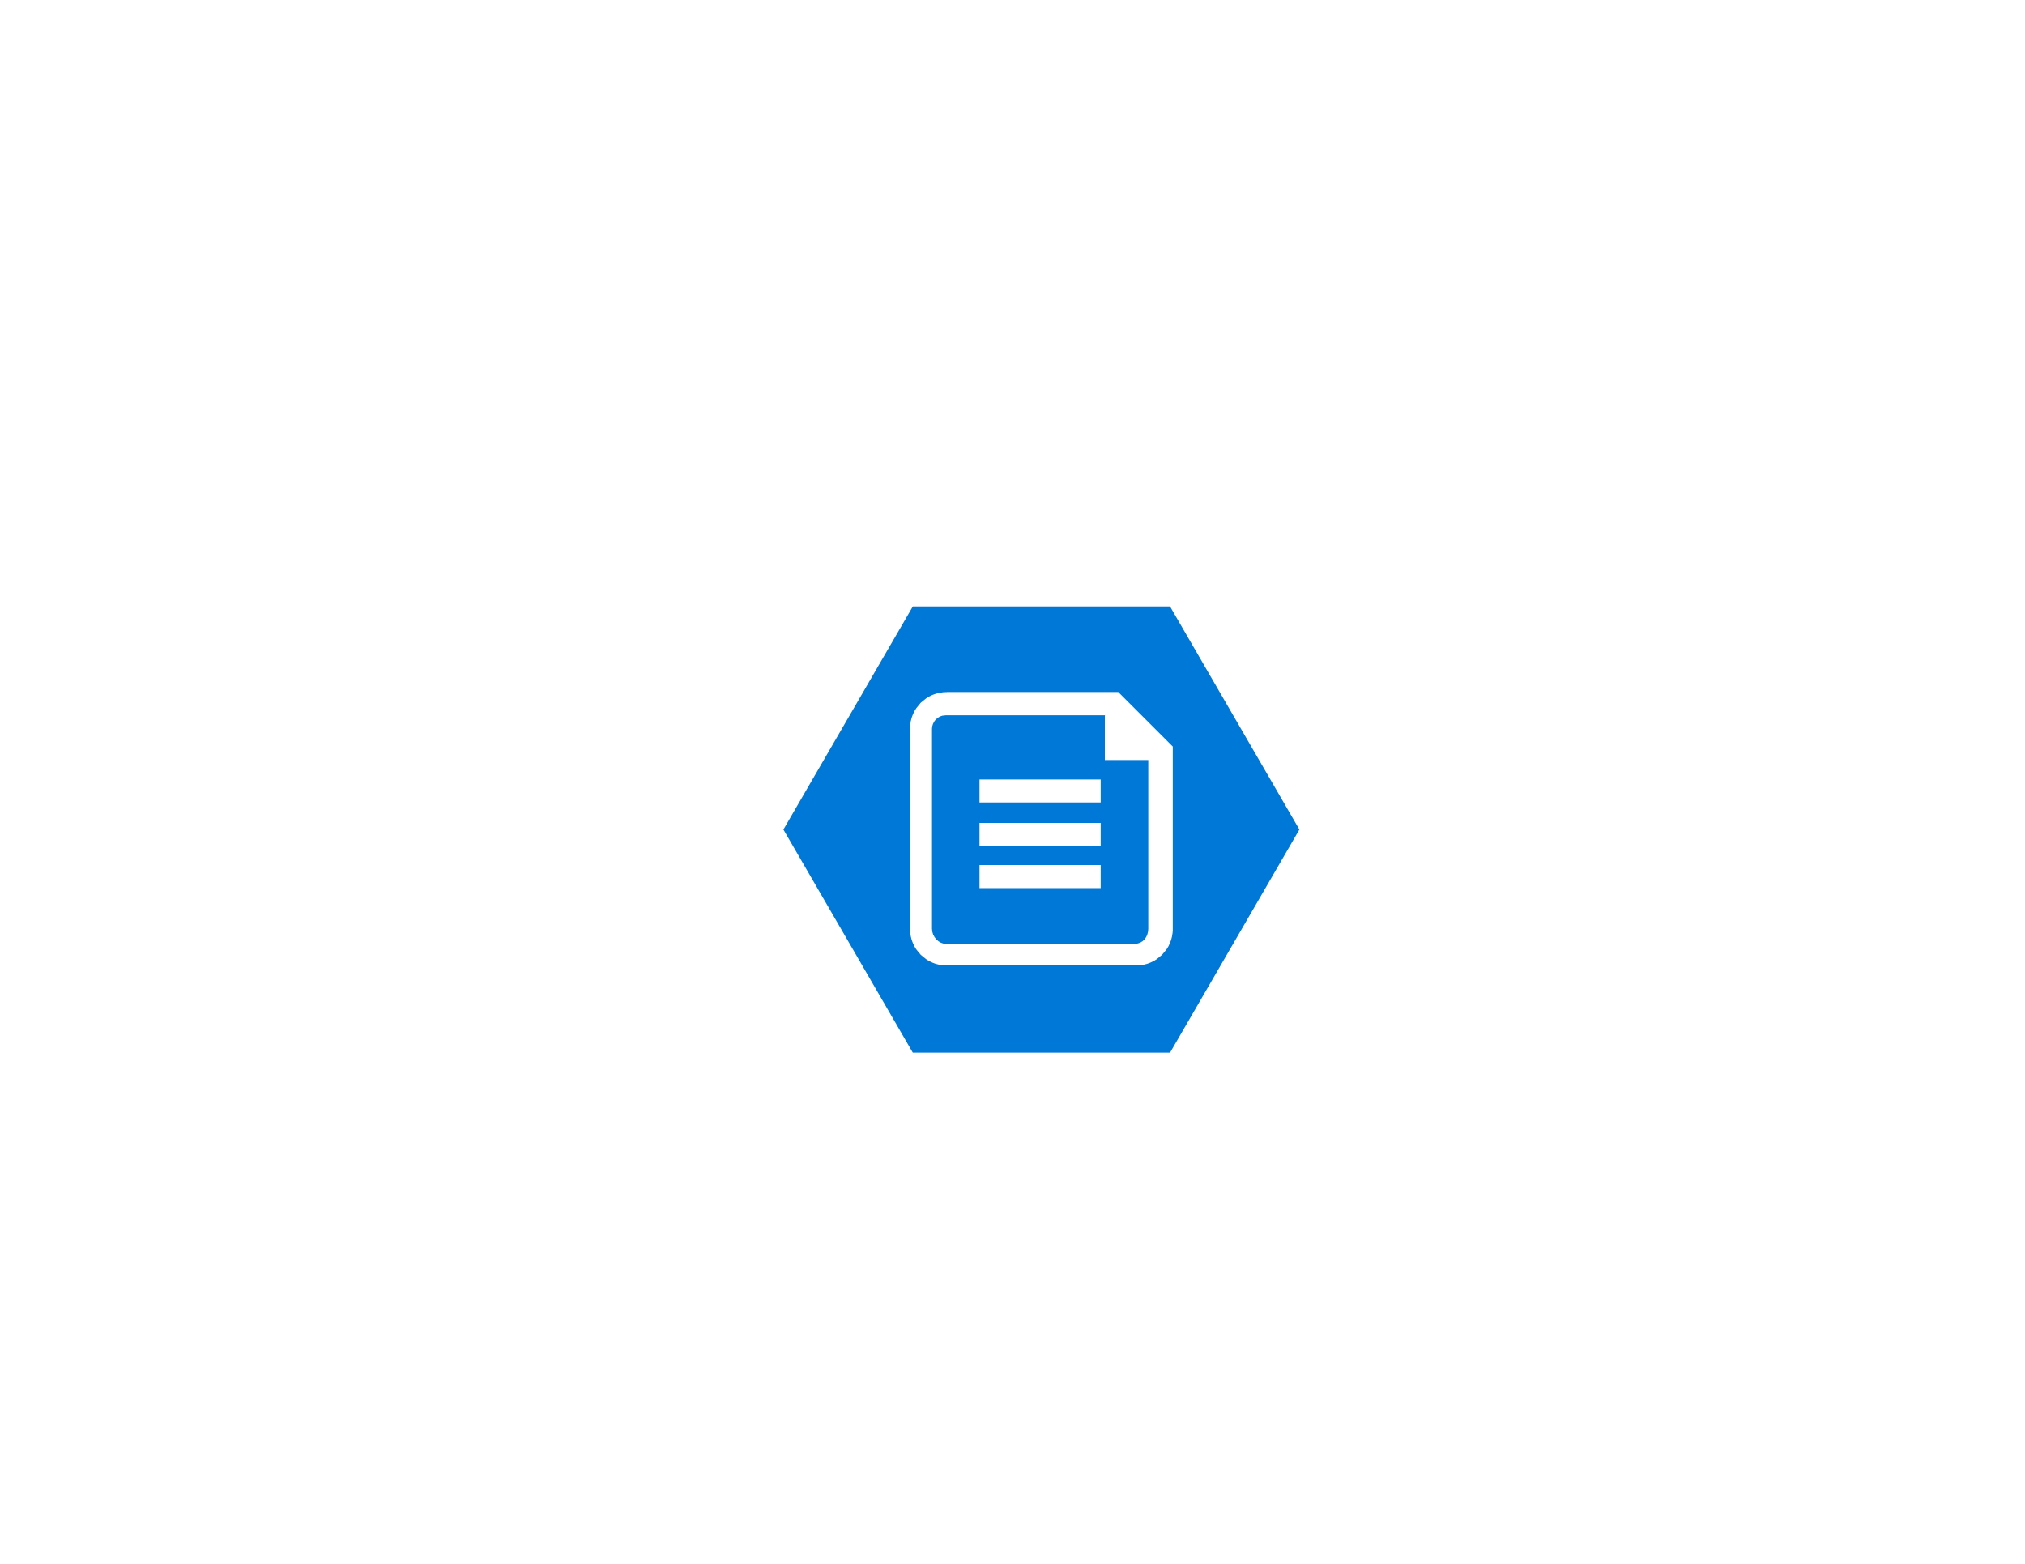
Azure Files
Benefits
Limitations
PaaS Service
Highly Available
Redundant
Encrypted
Cheap
SMB 2.1 & 3
Built In Backup
AAD Integration
Premium Version
Security
No ACLs
Use of Storage Key
External Access
Performance
5TB Size Limit 100 TB Preview
1TB File Limit

Slide 7
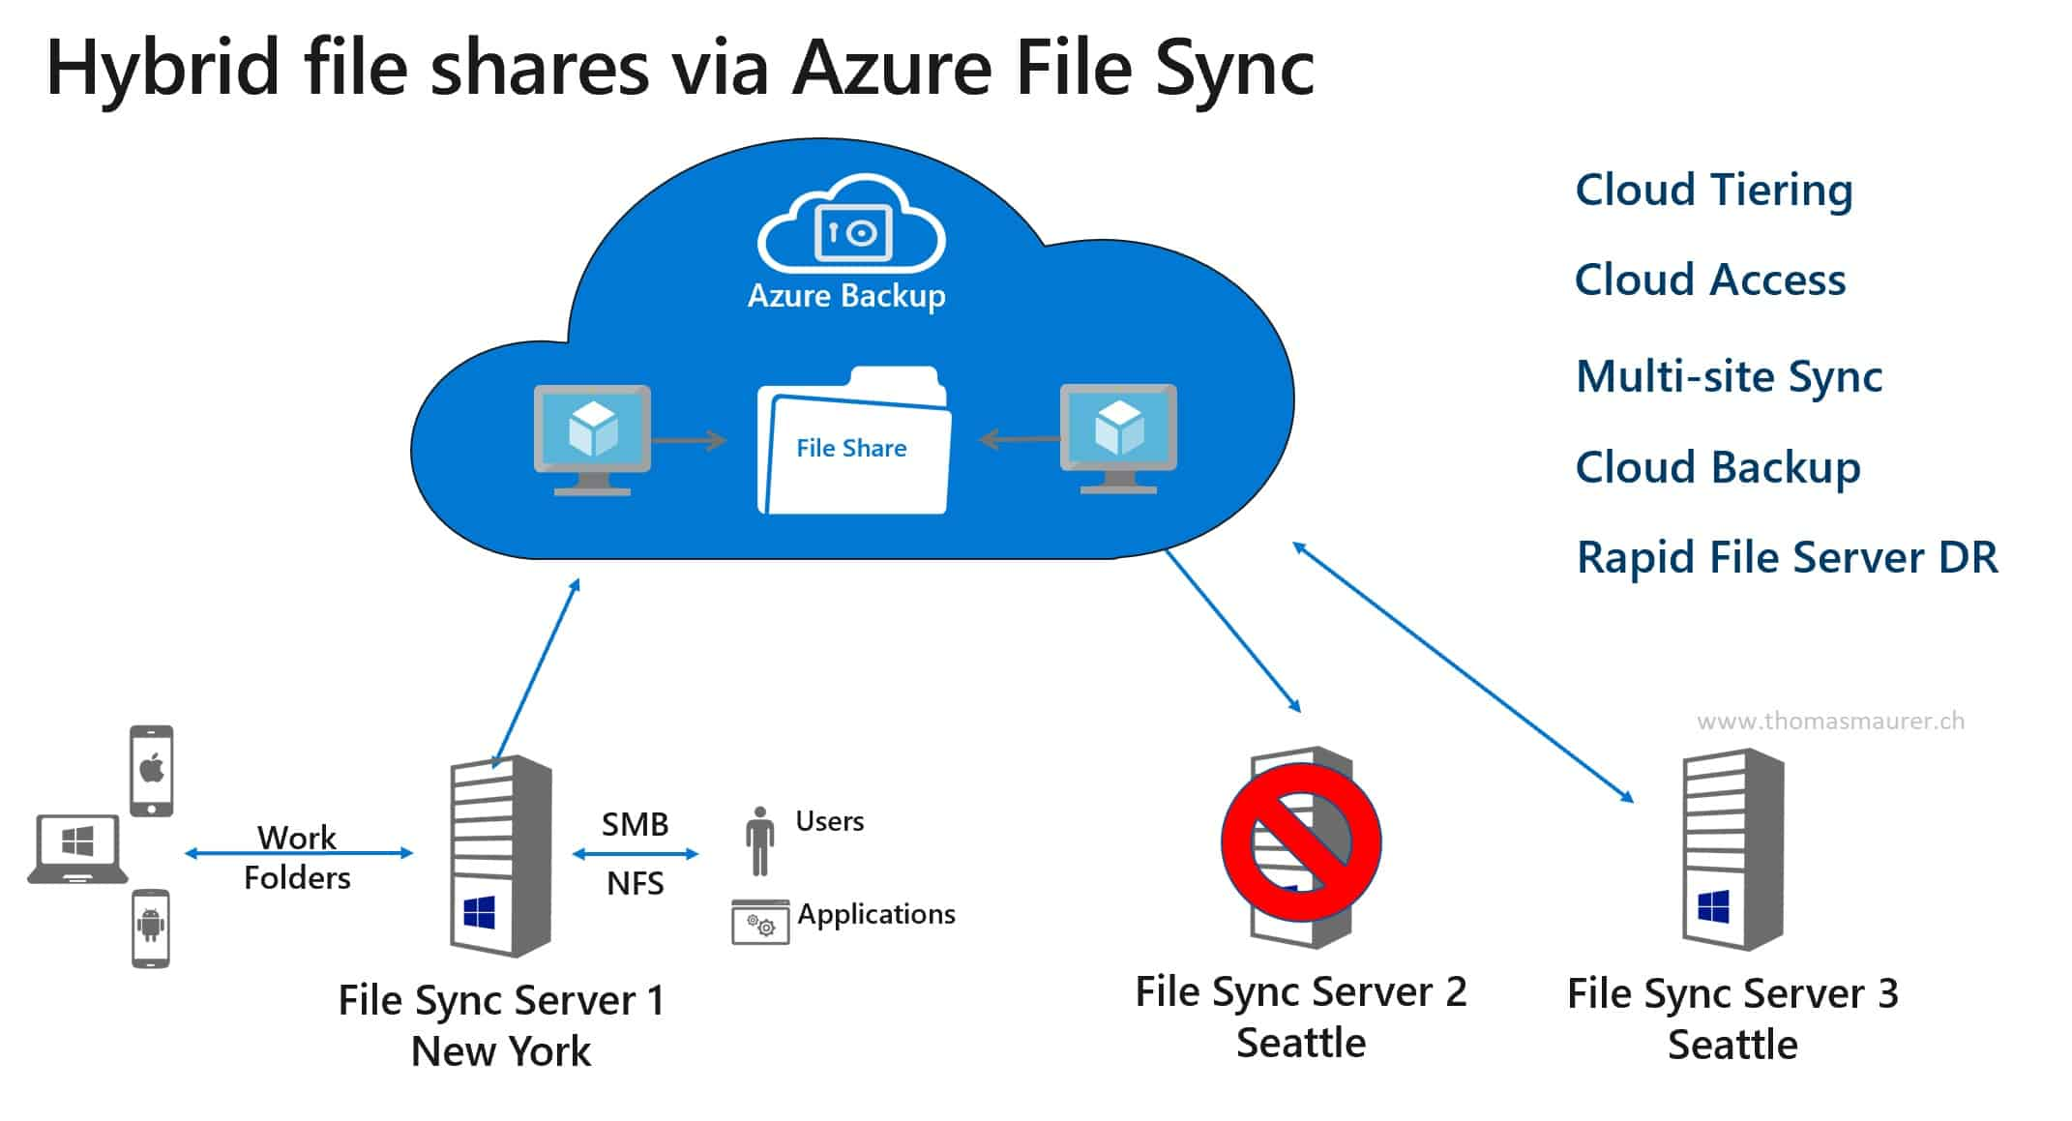
Source: https://www.thomasmaurer.ch/2019/04/sync-file-servers-with-azure-file-sync-in-windows-admin-center/

Slide 8

Standalone File Server
Benefits
Limitations
99.9% SLA
No performance hit for replication
Simple Backup
Reduced Cost
Simple Management
Single Point of Failure
Reduced SLA
Maintenance = Downtime
Reliance on Backup

Slide 9
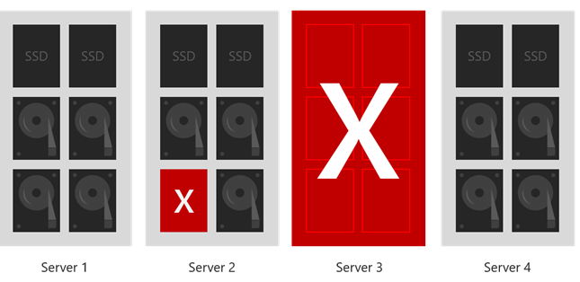
Storage Spaces Direct
New Server 2016 feature for creating a “no shared storage” cluster using storage spaces.

Slide 10

Storage Spaces Direct
Benefits
Limitations
True Active/Active Cluster
Instant Failover
Highly Available
99.95% SLA
Supports Cloud Witness
Limited supported workloads
Performance Concerns
Additional Cost
Backup Limitations
Requires Server 2016

Slide 11
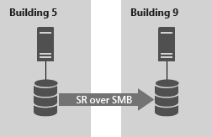
Storage Replica
New Server 2016 feature for replicating data between servers
Synchronous and Asynchronous Replication
Block Level
SMB3
Network Constraints
Server or Cluster Replication

Slide 12

Storage Replica
Benefits
Limitations
Block level replication
Choice of sync or async
Simpler Backup
Can combine with S2D
Works with DFSR Namespaces
Intended for DR
Failover not automated
One to One Replication
No access to data on non active node
PowerShell Management Only
Requires Server 2016

Slide 13
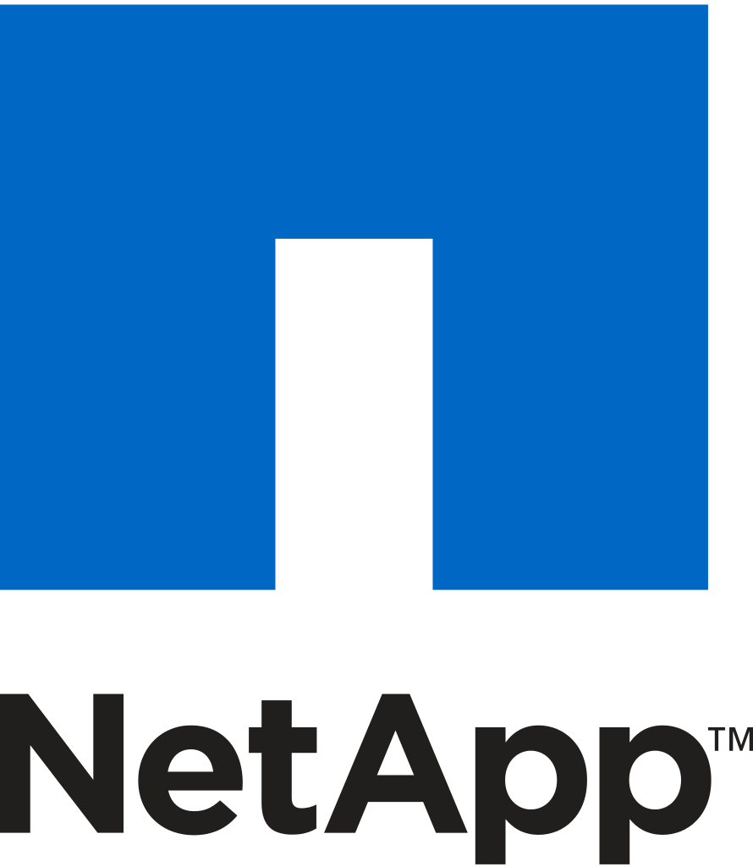
Azure Netapp Files
Benefits
Limitations
PaaS Service
Highly Available
High Performance
Redundant
Encrypted at Rest
SMB and NFS
Snapshots
AAD Integration
Premium and Ultra SKUs
Requires Activation
Limited Regions
No NSG Support
No Replication
Billed for all usage
4TB Minimum
Manual Snapshots
More Expensive
Notes:
Policy creation, show code
Policy Type:
Deny: generates an event in the activity log and fails the request
Audit: generates a warning event in activity log but doesn't fail the request
Append: adds the defined set of fields to the request
AuditIfNotExists: enables auditing if a resource doesn't exist
DeployIfNotExists: deploys a resource if it doesn't already exist
Disabled: doesn't evaluate resources for compliance to the policy rule
Language - https://docs.microsoft.com/en-us/azure/governance/policy/concepts/definition-structure#policy-rule
Initiatives

Slide 14

DFSR
Benefits
Limitations
Multi Server Replication
Automated Failover
Simple Backup
99.95% SLA
Failover not Instant
No replication of open files
Performance
Prone to issues
Not Synchronous
Difficult to manage

Slide 15

Third Party Solutions
Netapp Cloud Volumes ONTAP
SIOS Data Keeper
SoftNAS

Slide 16

Third Party Solutions
Benefits
Limitations
Supports Failover Clustering
Of the shelf solution
Available in Marketplace
Abstracts Azure Storage Layer
Cost
Complexity
Support
Training

Slide 17



Summary
No solution is perfect
Pick the solution that has the best compromise for you
Test!

Slide 18
Sam Cogan
Solution Architect – Willis Towers Watson
Microsoft Azure MVP
samcogan.com
@samcogan
sam-cogan

